Slide 1


NUMBER CONVERTER
BY USING PYTHON
CREATED BY :-
JASVEER PARUCHURI
12323090

Slide 2
Key Components
Introduction
Objective & Scope Of the Project
Application Tools
Project Design
Flowchart
Data Flow Diagrams
Usecase Diagram
Testing And Validation
Conclusion
References

Slide 3
Introduction
This project is a Python-based GUI application for converting numbers between different bases: Binary, Decimal, Octal, and Hexadecimal. Built with Tkinter, it offers:
Interactive Design: User-friendly interface for seamless conversions.
Key Features: Convert, Reset, Backspace, and History Logging.
Educational Value: Helps understand base conversions and algorithms.
Practical Utility: Ideal for students, developers, and learning tools.
A simple, efficient, and customizable solution for base conversions!

Slide 4
Objective of the project
Simplify Base Conversions:
Enable quick and accurate conversion between Binary, Decimal, Octal, and Hexadecimal.
User-Friendly Interface:
Provide an intuitive GUI for easy operation, even for non-technical users.
Enhance Learning:
Help students and learners understand number systems through hands-on conversions, and mathematicians in daily tasks involving different number systems. .
Improve Efficiency: Save time by eliminating manual calculations and reducing errors in base conversions.
Real-World Applications:
Assist developers, engineers

Slide 5
Scope of the Project:-
To create a tool for converting numbers between different bases (Binary, Decimal, Octal, Hexadecimal) using Python and Tkinter.
Key Features:
Multi-Base Conversion: Convert numbers between Binary, Decimal, Octal, and Hexadecimal.
Input Validation: Ensure valid input for selected bases.
User-Friendly Interface: Simple Tkinter-based GUI with labels, input fields, and buttons.
History Recording: Log each conversion in a History.txt
Reset Function: Clear inputs and outputs for a fresh start.
Technical Components:
GUI: Built using Tkinter.
Conversion Logic: Functions for base conversions.
File Handling: Save conversion history.
Target Audience:
Students learning number systems.
Programmers and Engineers working with digital systems.

Slide 6
Application tools
Python Programming Language:
Simple and readable syntax
Extensive libraries (e.g., math, tkinter)
Cross-platform support (Windows, macOS, Linux)
Large community support
tkinter (GUI Library):
Built into Python (no extra installation needed)
Lightweight, minimal system resources
Cross-platform compatibility
Customizable UI for user-friendly interaction
Mathematical Functions for Base Conversion:
Division & Modulus for converting numbers between bases
String manipulation to display results in binary, octal, hexadecimal formats

Slide 7
Lists to store remainders during conversion
Strings to display final results in target base format
Error Handling and Validation:
Input validation to ensure valid numbers for the selected base
Error messages guide users to correct invalid input
Integrated Development Environment (IDE):
PyCharm/Visual Studio Code for efficient development
Code completion, debugging tools, and version control integration
Additional Tools:
Future enhancements:
Python’s Built-in Data Structures:
matplotlib for visualizing conversion results
pytest for unit testing and ensuring functionality

Slide 8
Project Design
Project Overview:
This is a graphical user interface (GUI) application that allows users to convert numbers between different bases: binary, decimal, octal, and hexadecimal. The tool includes:
User input: A text box where the user enters the number they wish to convert.
Conversion options: Two sets of checkboxes, one for selecting the base of the input value, and one for selecting the base to convert it to.
Conversion functionality: The program will convert the number based on the selected input and output bases.
Result display: After conversion, the results are displayed in labels corresponding to each base.

Slide 10
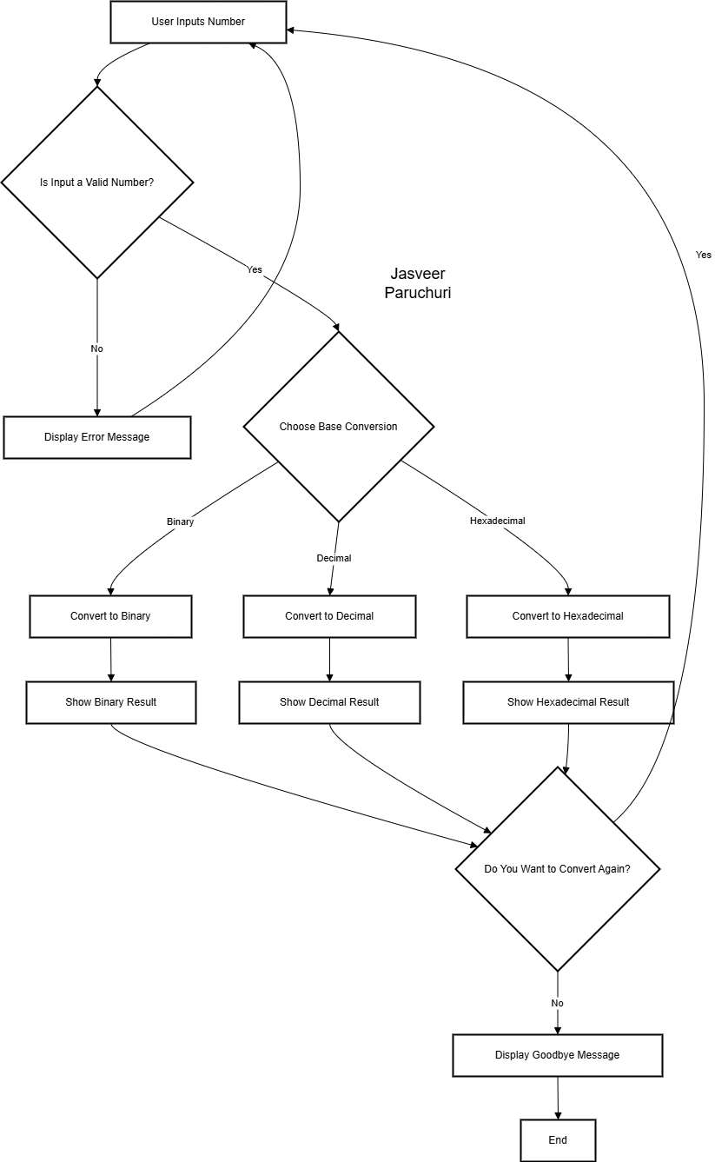
Flow chart

Slide 11
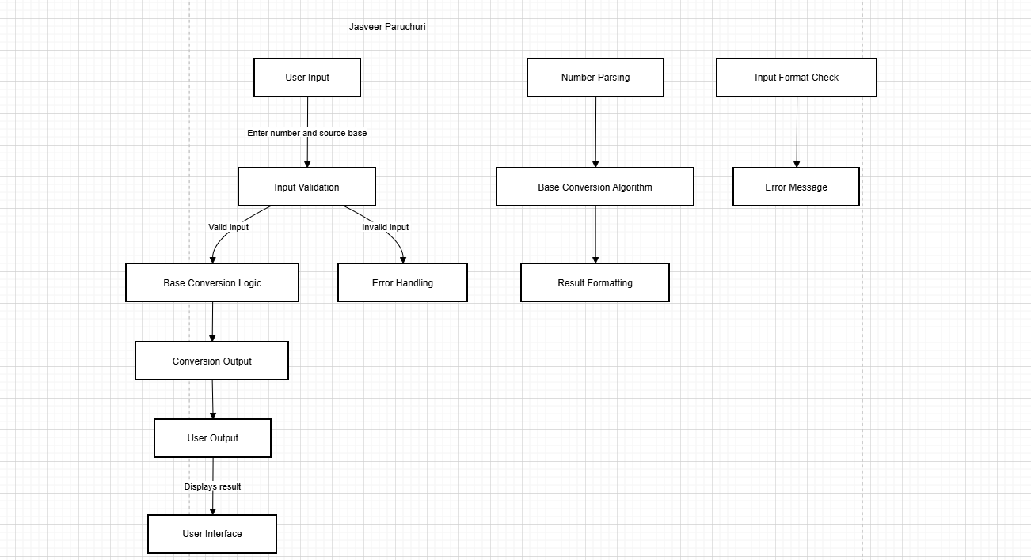
Data Flow Diagram

Slide 12
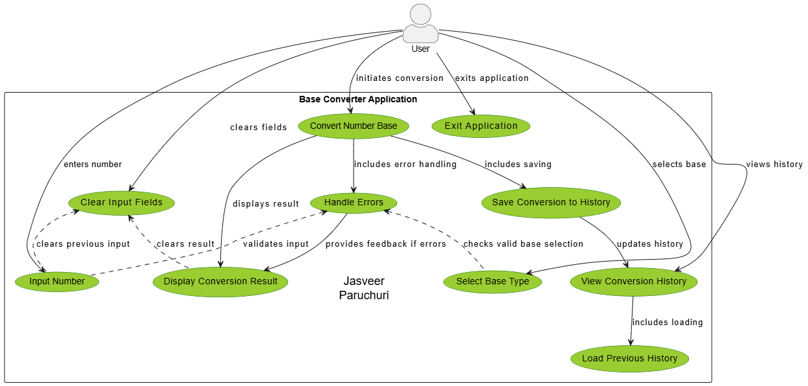
UseCase Diagram

Slide 13
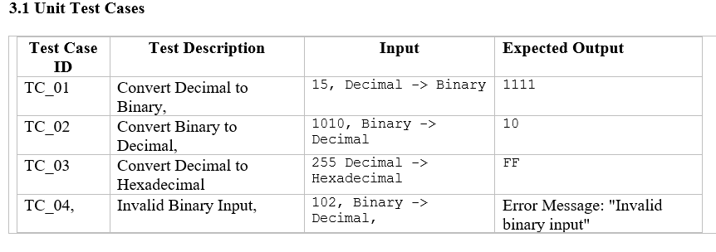
Testing and Validation

Slide 14
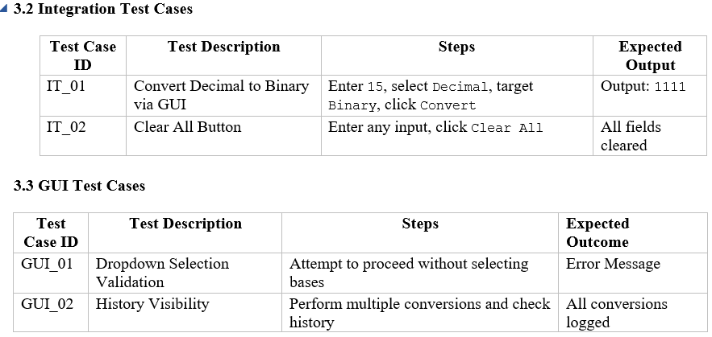
Validation Process
Create a Test Environment:
Set up the application in a controlled environment.
Install any dependencies (e.g., Python, required libraries).
Run Test Cases:
Execute test cases using the plan above.
Record pass/fail results.
Fix Issues:
Address any failures or bugs identified.
Retest to ensure fixes work and don't introduce new issues.
Document Results:
Prepare a report with test cases, results, and any issues resolved.

Slide 15
Conclusion
The Base Conversion System successfully meets the objectives set forth at the beginning of the project. It provides a user-friendly interface and robust functionality to convert numbers between different numeral systems (binary, decimal, and hexadecimal). This project demonstrates the seamless integration of computational logic with a graphical user interface to deliver a practical, real-world application
Key Accomplishments
Accurate Base Conversions:
The application supports conversions with precise accuracy
across supported numeral
systems.
User-Centric Design:
The graphical interface ensures intuitive navigation, allowing users of varying technical backgrounds to interact with the
system effectively.
Error Handling:
Comprehensive input validation ensures the application
handles invalid data gracefully, minimizing user frustration.
Performance:
The system efficiently processes conversions, even for large inputs, ensuring reliability under high workloads.
History Management:
Users can track and reuse their previous conversions,
improving usability and reducing
repetitive tasks.

Slide 16
References
Python Documentation
Python Official Documentation: https://docs.python.org/
Used for understanding language syntax, libraries, and error-handling mechanisms.
Tkinter Documentation
Python Tkinter GUI Programming: https://docs.python.org/3/library/tkinter.html
Resource for implementing the graphical user interface (GUI).
IEEE Standard for Floating-Point Arithmetic
Referenced for understanding the representation of numerical values in various bases.
Numeral Systems
Wikipedia: Numeral Systems Overview: https://en.wikipedia.org/wiki/Numeral_system
Provided foundational knowledge about binary, decimal, hexadecimal, and other numeral systems.
PlantUML Documentation
PlantUML User Guide: https://plantuml.com/
Used for creating and verifying data flow diagrams (DFDs).
Stack Overflow
Community Q&A Platform: https://stackoverflow.com/
Used for troubleshooting and code optimization during development.

Slide 17
Learning outcome’s
Technical Skills:
Gained expertise in Python programming for logic implementation.
Developed proficiency in GUI design using libraries like Tkinter or PyQt.
Enhanced understanding of numeral systems and their conversions.
Project Development:
Learned the importance of modular design for easier maintenance and scalability.
Applied structured testing and validation methods to ensure a high-quality product.
Problem Solving:
Overcame challenges in error handling, input validation, and GUI responsiveness through iterative development.

Slide 18

This Photo by Unknown Author is licensed under CC BY-SA

